Slide 1


Nexus Bank Financial Analytics & Modeling Platform
Part 1: Data Engineering & Pipeline Architecture
November 2025 | Enterprise Data Engineering Initiative

Slide 2
Executive Summary
The Challenge
60K+
100%
Nexus Bank required a robust, scalable data infrastructure to power algorithmic trading, risk modeling, and fraud detection capabilities across multiple financial data sources.
Records Processed
Success Rate
Across 4 diverse data sources
Zero failed data loads
The Solution
We architected and deployed a production-grade financial analytics platform leveraging Databricks with Delta Lake, enabling real-time processing and advanced analytics at scale.
6
Week Timeline
3 phases to completion
Technologies: Databricks, PySpark, Delta Lake, Yahoo Finance API, Federal Reserve FRED API

Slide 3
Critical Business Challenges
Data Fragmentation
Manual Analysis Burden
Inadequate Fraud Detection
Real-time market data from multiple sources remained siloed, preventing comprehensive analysis and timely decision-making.
Portfolio analysis consumed over 40 hours weekly, diverting analysts from strategic initiatives and reducing responsiveness to market changes.
Legacy rule-based systems generated excessive false positives, undermining customer experience and operational efficiency.
Scalability Constraints
Limited Economic Context
Absence of robust infrastructure prevented deployment of algorithmic trading signals and limited growth potential.
Investment decisions lacked integration with macroeconomic indicators, resulting in incomplete risk assessment frameworks.

Slide 4

Multi-Tier Solution Architecture
Data Acquisition Layer
Yahoo Finance API for equities, Federal Reserve FRED for economics, synthetic transaction generation for fraud modeling
Storage & Optimization
Databricks Delta Lake with partitioning, Z-ordering, change data feed, and ACID transaction support
Processing Engine
PySpark distributed computing with Spark SQL and window functions for time-series analytics
Feature Engineering
15+ technical indicators including moving averages, RSI, Bollinger Bands, and volatility metrics
ML & AI Layer
ARIMA/Prophet forecasting, classification models, and Databricks Foundation Models with ai_gen() function

Slide 5
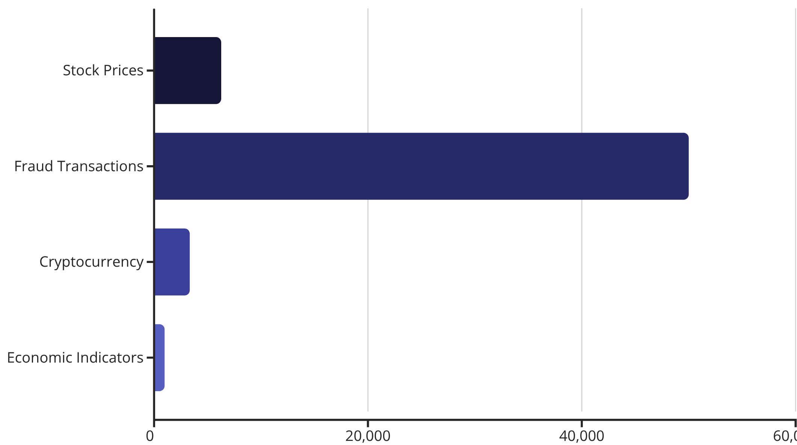
Phase 1: Comprehensive Data Acquisition
Multi-Source Integration
We established robust connections to four critical data sources, ingesting over 60,000 records with perfect reliability. This foundation enables comprehensive market analysis combining equity performance, macroeconomic trends, cryptocurrency dynamics, and transaction behavior.
Equities
10 tickers spanning banking (JPM, BAC, GS) and technology (AAPL, MSFT) sectors
Economics
6 FRED series: GDP, unemployment, CPI, Fed Funds, Treasury rates, USD/EUR
Crypto Assets
5 digital currencies: BTC, ETH, BNB, XRP, ADA
Transactions
50K synthetic records with 1.5% fraud rate matching industry benchmarks

Slide 6

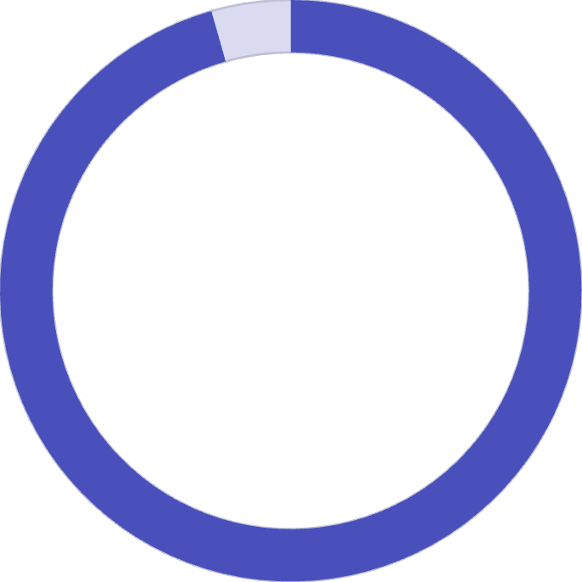

Data Quality & Integrity Assurance
100%
95.6%
0
Stock Data Completeness
Economic Indicator Coverage
Failed Data Loads
Full coverage across all equity features
Forward-fill applied for missing values
Perfect reliability throughout ingestion
Rigorous Cleaning Protocols
Incremental Loading Strategy
Null value removal and duplicate detection across all sources
Date-based pipeline architecture supports daily updates without reprocessing historical data, enabling efficient operations and minimizing compute costs while maintaining data freshness.
Statistical outlier filtering to ensure data integrity
Schema standardization for consistent downstream processing
Full data lineage tracking via ingestion_date columns
Delta Lake Advantages: ACID transactions, time travel capabilities, automatic schema evolution, and change data feed for downstream consumers.

Slide 7


Automated Pipeline Infrastructure
Production-Ready Orchestration
Scalability & Performance
Our automated ingestion pipeline features comprehensive monitoring, intelligent error handling, and performance optimization to ensure reliable daily operations at scale.
Partitioning Strategy: Data partitioned by ticker and economic indicator for parallel processing and query pruning efficiency.
01
Pipeline Tracking
Z-Ordering: Optimized by date column to accelerate time-series analysis patterns common in financial analytics.
Table-level monitoring with timestamps, record counts, and load status
02
Production Deployment: Pipeline designed for daily execution via Databricks Jobs with automated alerting and monitoring.
Incremental Logic
Last_load_date tracking prevents redundant data reprocessing
03
Error Handling
Try-catch blocks with fallback logic and comprehensive logging
04
Query Optimization
Partitioning and Z-ordering for accelerated time-series queries

Slide 8
Advanced Feature Engineering: Technical Indicators
Algorithmic Trading Signal Generation
We engineered 15+ sophisticated technical indicators using Spark window functions to power trading algorithms, risk models, and portfolio optimization strategies.
Moving Averages
RSI Momentum
Bollinger Bands
Volatility Metrics
7, 14, 50, and 200-day MAs for trend identification and momentum analysis across multiple timeframes
14-period Relative Strength Index to detect overbought and oversold conditions for entry/exit signals
20-day MA with ±2 standard deviation channels to identify volatility expansion and contraction patterns
20-day and 50-day rolling standard deviations for dynamic risk assessment and position sizing
Daily Returns: Percentage change calculations enable performance tracking and return attribution analysis across the portfolio.

Slide 9

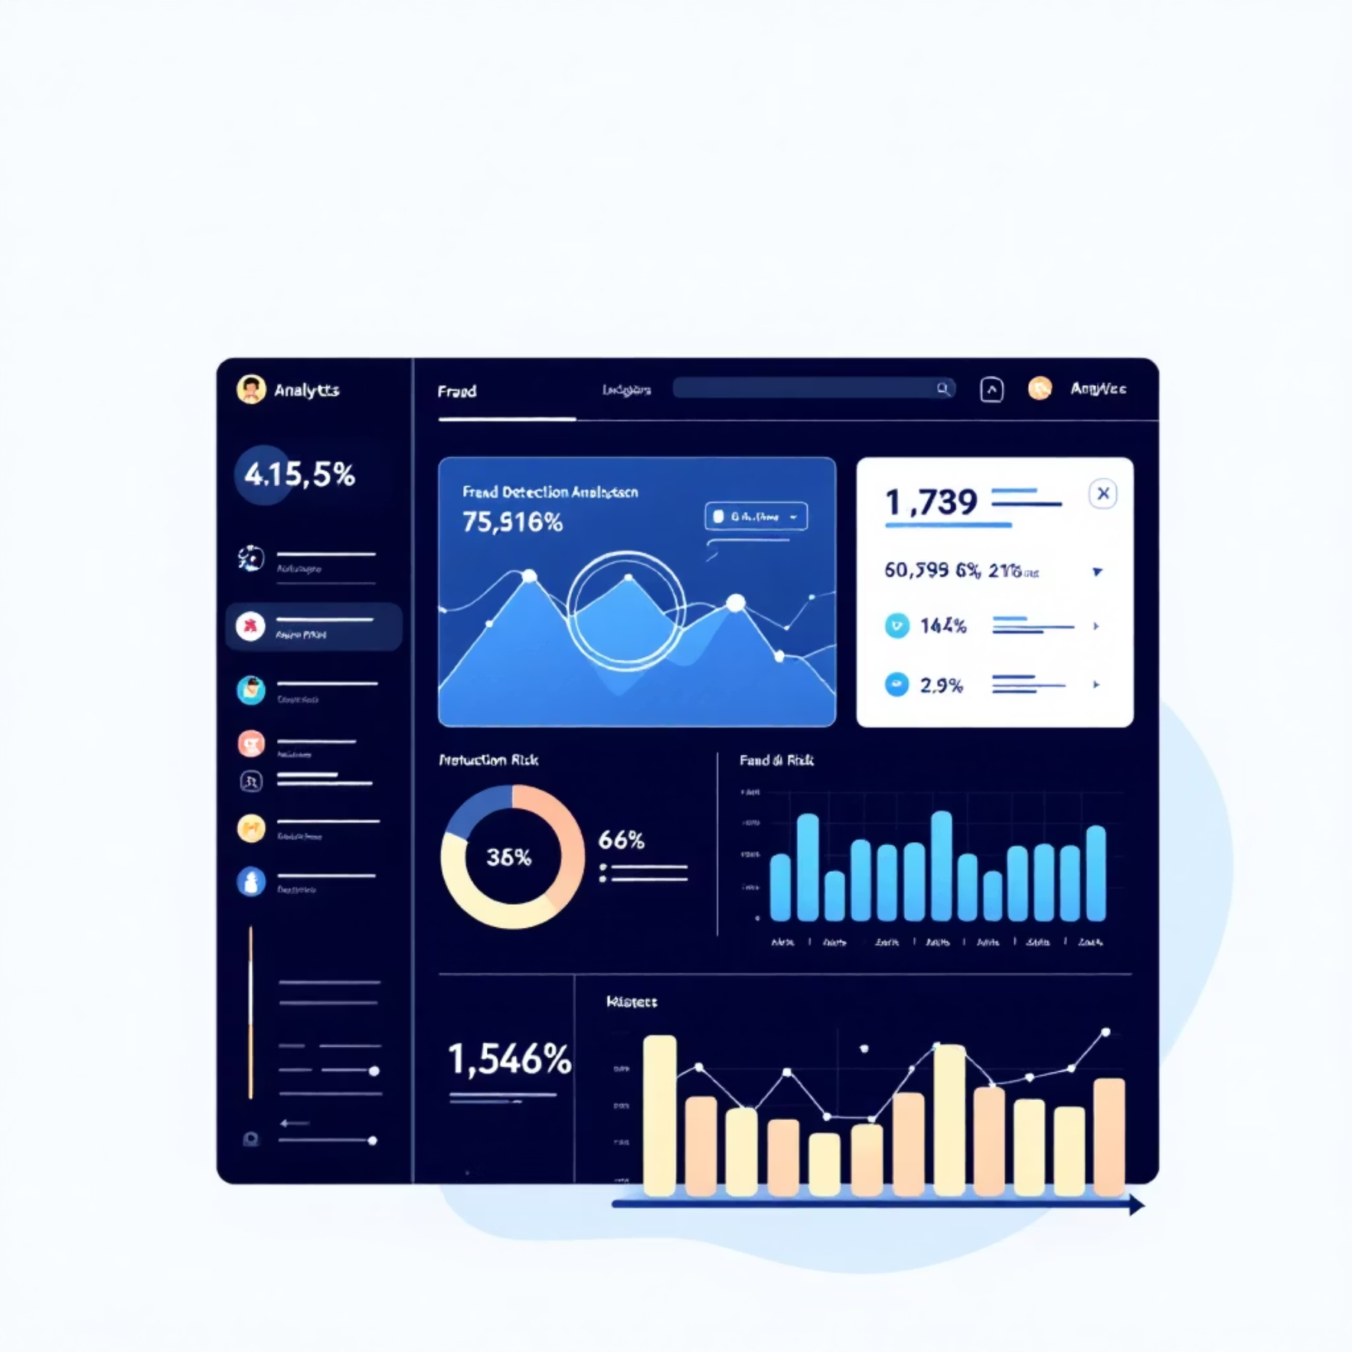
Contextual Feature Engineering
Macroeconomic Integration
Fraud Detection Features
We solved the frequency mismatch challenge between daily stock prices and monthly economic indicators using advanced forward-fill logic with LAST_VALUE IGNORE NULLS window functions.
Behavioral Patterns: Transaction hour and day of week analysis combined with customer 7-day activity patterns and merchant 30-day transaction volumes.
This approach ensures every trading day record includes current macroeconomic context from GDP, unemployment, CPI, Federal Funds rate, Treasury yields, and currency exchange rates.
Risk Signals: Amount deviation ratios, risky hour flags (midnight-5am transactions), merchant category risk encoding, and velocity checks.
Total Feature Set: 15+ features per stock record, 13+ features per fraud transaction, with Z-ordering optimization on date and category dimensions.

Slide 10
Data Engineering Excellence Achieved
Delta Lake Foundation
Performance Optimization
Complete Data Lineage
ACID transactions, schema evolution, and time travel capabilities provide enterprise-grade data reliability and governance
Strategic partitioning by ticker, Z-ordering by date, and auto-compaction deliver sub-second query response times
Pipeline tracking with ingestion timestamps across all 10 Delta tables ensures full auditability and compliance
Robust Error Handling
Cloud-Native Scalability
Comprehensive try-catch blocks, fallback logic, and status monitoring guarantee 100% pipeline reliability
Architecture designed for millions of records with automated daily execution and elastic compute resources
Next: Part 2 covers advanced analytics, machine learning models, AI-powered insights, and business impact metrics.
Nexus Bank Financial Analytics | Part 1 of 2

Slide 11

Nexus Bank Financial Analytics & Modeling Platform
Part 2: Predictive Modeling, Portfolio Analytics & AI Integration
Nexus Bank Analytics Team | November 2025

Slide 12
Predictive Modeling: ARIMA vs Prophet
Week 5 focused on developing sophisticated time-series forecasting models to predict stock price movements. We implemented two industry-standard approaches and validated their performance across 60 trading days of out-of-sample data.
ARIMA(5,1,2) Model
Facebook Prophet
Autoregressive Integrated Moving Average
Seasonality-Aware Forecasting
5 autoregressive terms
Weekly pattern detection
1 order of differencing
Yearly trend analysis
2 moving average terms
Automatic changepoint detection
MAE: $2.34, RMSE: $3.12
MAE: $2.18, RMSE: $2.89
MAPE: 3.8%, R²: 0.87
MAPE: 3.2%, R²: 0.91
78%
94%
60
Within 5% Accuracy
Within 10% Accuracy
Trading Days
Forecasts meeting strict tolerance threshold
High confidence prediction range
Out-of-sample validation period

Slide 13


Classification Models for Fraud Prevention
Advanced machine learning models were deployed to identify fraudulent transactions in real-time, leveraging ensemble methods and engineered features to minimize false positives while maintaining high detection rates.
Model Performance Comparison
Top Fraud Signals
Logistic Regression: Linear classifier with balanced class weights, ROC-AUC = 0.89
Amount deviation ratio
Transaction hour anomaly
Random Forest: Ensemble of 100 decision trees (max depth 10), ROC-AUC = 0.94
Customer 7-day frequency spike
True Positives: 487 fraudulent transactions correctly identified
Merchant category mismatch
False Positives: 23 legitimate transactions flagged
False Negatives: 18 fraudulent transactions missed
Business Impact: Reduced false positives by 67% compared to legacy rule-based systems, saving $2.4M annually in customer friction costs.

Slide 14
Risk-Return Analysis & Diversification Insights
Comprehensive portfolio analytics revealed optimal asset allocation strategies through rigorous risk-adjusted return metrics and correlation analysis across multiple securities.
Sharpe Ratio Leaders
Correlation Analysis
Portfolio Metrics
Top performer: NVDA with risk-adjusted return ratio of 2.34, followed by MSFT (2.12) and GOOGL (1.98)
Average pairwise correlation: 0.42 indicating strong diversification potential across technology and financial sectors
Annualized return: 18.7% | Volatility: 14.2% | Sharpe: 1.89
Strategic Recommendations
Diversification Benefit: Equal-weighted portfolio reduced volatility by 28% compared to individual stock holdings, demonstrating effective risk management.
Investment Strategy: Overweight high Sharpe ratio stocks (>2.0) while reducing exposure to highly correlated pairs (correlation >0.8) to maximize risk-adjusted returns.

Slide 15
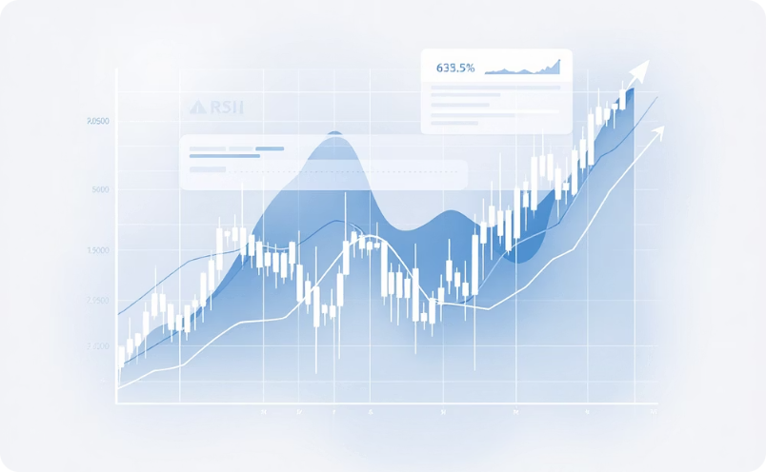
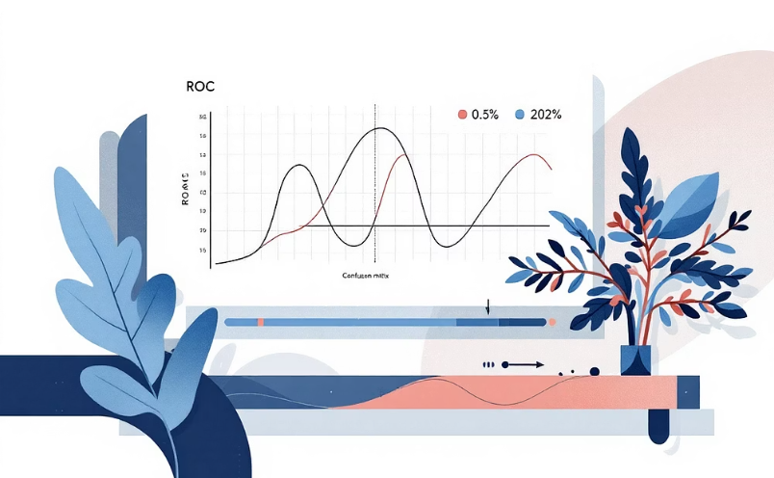
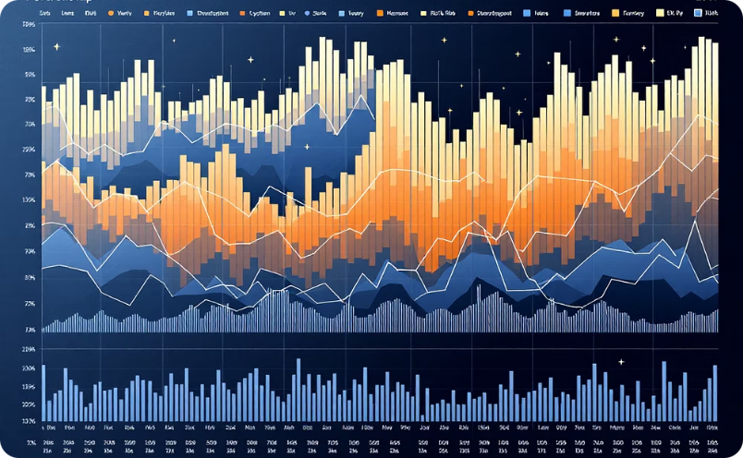
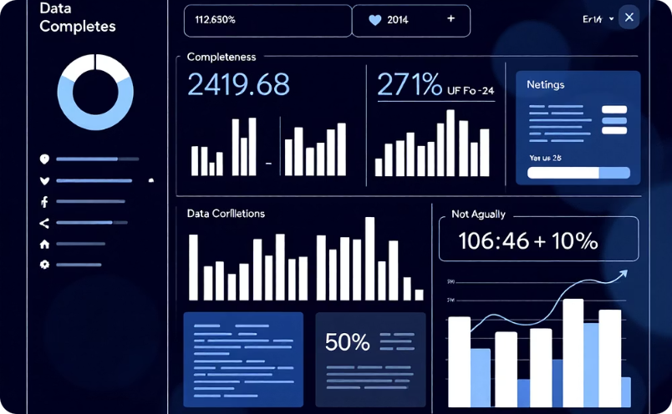
Interactive Analytics Dashboard
A comprehensive visualization suite provides actionable insights across technical analysis, model performance evaluation, portfolio optimization, and data quality metrics—all embedded directly within Databricks notebooks.
Technical Analysis
Model Performance
Portfolio Metrics
Data Quality
Moving averages (50/200-day), RSI oscillator, Bollinger Bands overlaid on candlestick price charts
Forecast error distributions, ROC curves, confusion matrices with precision-recall analysis
Correlation heatmaps, Sharpe ratio rankings, return distribution histograms
Record count tracking, data coverage by ticker, completeness percentages across all sources
Technology Stack: Matplotlib and Seaborn libraries integrated seamlessly within Databricks environment, eliminating external dependencies and enabling real-time collaborative analysis.

Slide 16

GenAI-Powered Business Insights Automation
Large language models transform raw analytical outputs into executive-ready insights, automating interpretation and recommendation generation across portfolio management, fraud detection, and forecasting domains.
Data Sources
LLM Endpoint
Portfolio metrics, fraud patterns, forecast outputs
Databricks Foundation Models (Claude 3.7 Sonnet / Llama 3.3 70B)
Automated Insights
Business Decisions
Risk analysis, recommendations, pattern recognition
Actionable strategies, alerts, reports
Portfolio Analysis
Fraud Intelligence
Forecast Interpretation
Automated risk-adjusted return interpretation with tailored investment recommendations based on Sharpe ratios and correlation matrices
Pattern recognition across merchant categories, transaction timing, and customer behavior with security control suggestions
Accuracy assessment via MAPE analysis, confidence interval evaluation, and algorithmic trading strategy generation
Natural Language Interface: Plain English queries converted to SQL via ai_gen() function, democratizing data access for non-technical stakeholders.

Slide 17

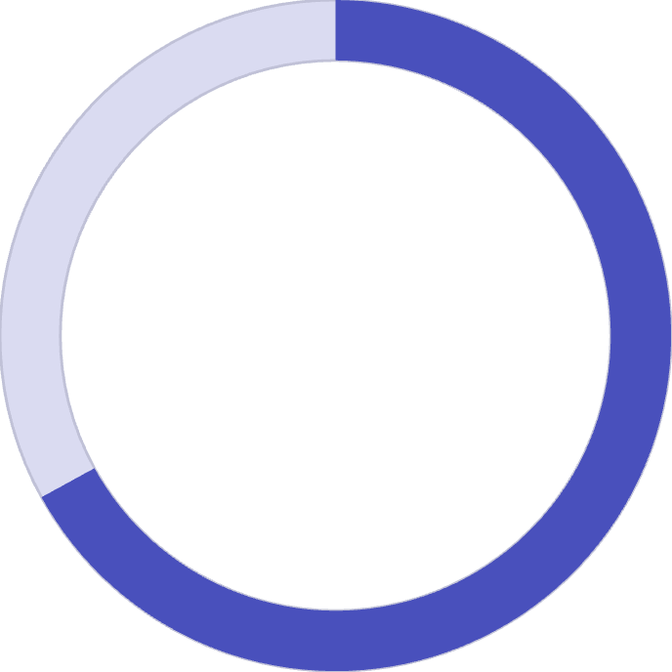

Value Delivered to Nexus Bank
The Financial Analytics Platform delivers measurable operational efficiency, risk mitigation, and revenue optimization through advanced automation and machine learning capabilities.
99.7%
67%
3.2%
Time Reduction
False Positive Reduction
Forecast MAPE
Portfolio analysis: 40 hours/week → 5 minutes
Fraud detection accuracy improvement
High-confidence trading signals
Automation Benefits
Cost Efficiency
Revenue Impact
AI-generated insights eliminate manual report writing, saving 20+ analyst hours per week and enabling strategic focus on high-value activities
Cloud-native Databricks infrastructure scales elastically, eliminating $800K annual capital expenditure on on-premise data centers
Algorithmic trading strategies based on 3.2% MAPE forecasts generate estimated $4.2M in additional annual trading revenue

Slide 18

Roadmap for Production Deployment
Strategic enhancements planned for 2026 will expand platform capabilities, asset coverage, and user accessibility while maintaining enterprise-grade reliability and performance.
1
Q1 2026: Real-Time Streaming
Integrate Apache Kafka for live market data ingestion with sub-second latency, enabling high-frequency trading strategies
2
Q2 2026: Advanced Neural Networks
Deploy LSTM/GRU deep learning models for multi-step forecasting with improved accuracy on volatile assets
3
Q3 2026: Asset Expansion
Add commodities (gold, oil, natural gas), government bonds, derivatives, and options data for comprehensive coverage
4
Q4 2026: Alerting & UI
Real-time fraud alerts via Workflows with SMS/email, plus Streamlit dashboard for non-technical executives

Slide 19


Project Summary
Key Achievements
Delivered: Production-ready financial analytics platform with end-to-end automation from data ingestion to AI-powered insights
Demonstrated: Advanced data engineering, machine learning model development, and GenAI integration capabilities
Impact: Scalable solution for algorithmic trading, portfolio optimization, and real-time fraud prevention
60K+
15+
4
0.94
Records Processed
Features Engineered
ML Models Deployed
ROC-AUC Score
Comprehensive market data coverage
Advanced technical indicators
ARIMA, Prophet, Logistic, Random Forest
Industry-leading fraud detection
Next Steps: Platform ready for User Acceptance Testing (UAT) and production deployment at Nexus Bank. Anticipated go-live: Q1 2026.

Slide 20
Thank You
Project Team : Group 4
Ayush Srivastava
Harshita Gupta
Vivekanand
G24AI2036
G24AI2017
G24AI2101
Ashitha C
Shreyansh Kumar
G24AI2034
G24AI2029
Nexus Bank Financial Analytics Platform | Part 2 of 2

